Slide 1

SDET Course
Design Patterns - Interpreter

Slide 2
3 Types of Design Patterns
Creational
Singleton
Builder
Prototype
Factory Method
Abstract Factory
Structural
Adapter
Composite
Proxy
Flyweight
Bridge
Facade
Decorator
Behavioral
Strategy
Observer
Command
Memento
State
Template Method
Mediator
Chain of Responsibility
Interpreter
Visitor
Iterator

Slide 3
Agenda
Description
Diagram
Code sample (Java)
Use cases

Slide 4

Description
Introduction - Interpreter

Slide 5
Description
The Interpreter design pattern is a behavioral design pattern that is used to define a grammatical representation for a language and provides an interpreter to deal with this grammar. The pattern is particularly useful when there is a need to implement a language for expressing operations and statements that can be evaluated or executed by the software. This pattern involves defining an expression interface with an interpret method and implementing this interface for different kinds of expressions. The interpreter uses a tree structure to represent the syntax of the language it interprets, with each node of the tree being an instance of an expression class. This pattern allows for the parsing and interpretation of the language sentences, offering a flexible and extendable way to integrate new expressions and functionality into the system without modifying the core code structure. It is widely used in compilers, parsers, and other language processing systems.

Slide 6
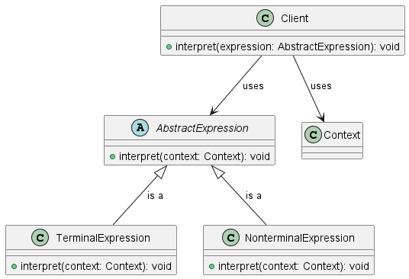
Class Diagram

Slide 7
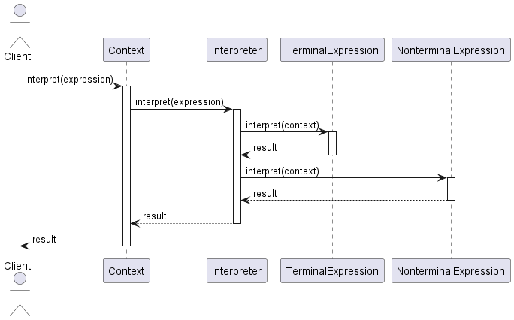
Sequence Diagram

Slide 8
Code Sample

Slide 9
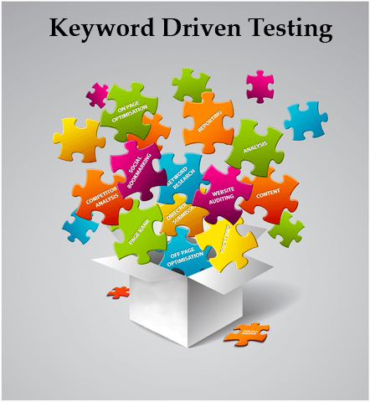

Use cases
General
SQL Query Interpretation
Programming Language Compilers
In Test Automation
Cucumber Design
Keyword Driven Testing
Image Source

Slide 10
KDT - Keyword Driven Testing
Definition: Keyword-driven testing is a software testing methodology that separates test script design and execution.
Approach: Tests are designed using a set of keywords representing actions or operations to be performed on the application under test.
Modularity: Tests are composed of reusable modules or keywords, enhancing maintainability and scalability.
Flexibility: Allows testers to create tests without scripting knowledge by using a predefined set of keywords.
Collaboration: Encourages collaboration between testers and domain experts to define meaningful keywords reflecting business requirements.
Automation: Enables automation by associating keywords with corresponding automation scripts or functions.
Maintenance: Eases test maintenance as changes in the application require updates only to the keyword implementations, not the test scripts.
Example: Keywords might include actions like "login," "search," "add to cart," etc., which are then combined to create test cases.

Slide 11
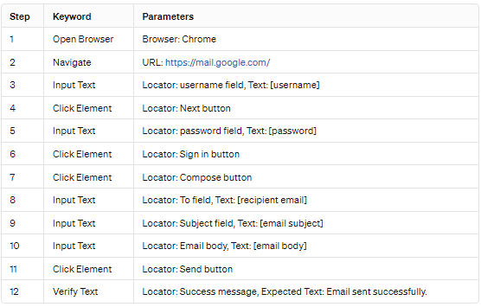
Send an Email Using Gmail - KDT

Slide 12
Happy Coding

